Slide 1
JSP Pagination

Slide 2
JSP Pagination
In this module we will see below topics
JSP Pagination
JSP Pagination Example

Slide 3
JSP Pagination
Pagination is a concept or rather a technique to divide the result set into smaller byte size pages for the user to browse through with ease. Pagination by definition is a process to divide content into discreet pages.
Before the progress of Information Technology, pagination was entirely a manual process and print layout was the sole intention. But in today’s world pagination is done mainly to enhance the speed of data fetching in a certain website. Fetching all the data at a time is a slow and resource intensive job, also the user who has to view through the entire list has a poor experience due to amount of data he has to scroll through. Well designed websites always take care of these issues and provide a user friendly experience.
Pagination can be used in server side and client side. Server side pagination is used when
Faster initial page loading is required
Complex business logic is required in view part
There are large data sets
Client side pagination is used when:
The data set is small
Subsequent page load is faster
Full support for sorting and filtering

Slide 4
JSP Custom tags Example Duration :30 min
MyTagHandler.java
Package com.test.customtag;
import java.util.Calendar;
import javax.servlet.jsp.JspException;
import javax.servlet.jsp.JspWriter;
import javax.servlet.jsp.tagext.TagSupport;
public class MyTagHandler extends TagSupport{
public int doStartTag() throws JspException {
JspWriter out=pageContext.getOut();//returns the instance of JspWriter
try{
out.print(Calendar.getInstance().getTime());//printing date and time using JspWriter
}catch(Exception e){System.out.println(e);}
return SKIP_BODY;//will not evaluate the body content of the tag
}
}

Slide 5
JSP Custom tags Example Duration :30 min
2) Create the TLD file
Tag Library Descriptor (TLD) file contains information of tag and Tag Hander classes. It must be contained inside the WEB-INFdirectory.
File: mytags.tld
<?xml version="1.0" encoding="ISO-8859-1" ?>
<!DOCTYPE taglib PUBLIC "-//Sun Microsystems, Inc.//DTD JSP Tag Library 1.2//EN" "http://java.sun.com/j2ee/dtd/web-jsptaglibrary_1_2.dtd">
<taglib>
<tlib-version>1.0</tlib-version>
<jsp-version>1.2</jsp-version>
<short-name>simple</short-name>
<uri>http://tomcat.apache.org/example-taglib</uri>
<tag>
<name>today</name>
<tag-class>com.test.customtag.MyTagHandler</tag-class>
</tag> </taglib>

Slide 6
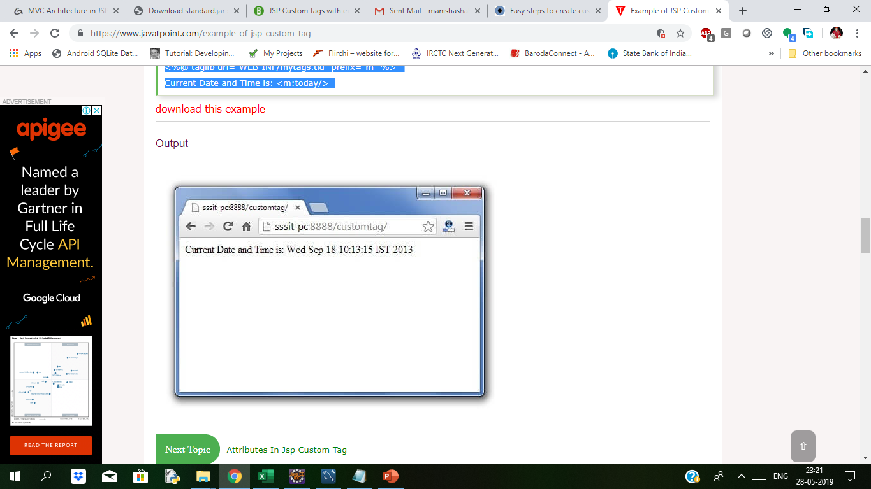
JSP Custom tags Example Duration :30 min
3) Create the JSP file
Let's use the tag in our jsp file. Here, we are specifying the path of tld file directly. But it is recommended to use the uri name instead of full path of tld file. We will learn about uri later.
It uses taglib directive to use the tags defined in the tld file.
index.jsp
<%@ taglib uri="WEB-INF/mytags.tld" prefix="m" %>
Current Date and Time is: <m:today/>
After running index.jsp we get following output.

Slide 7
Attributes Example Duration: 10 min
You can use various attributes along with your custom tags. To accept an attribute value, a custom tag class needs to implement the setter methods, identical to the JavaBean setter methods.
HelloTag.java
import javax.servlet.jsp.tagext.*;
import javax.servlet.jsp.*;
import java.io.*;
public class extends SimpleTagSupport {
private String messHelloTagage;
public void setMessage(String msg) {
this.message = msg; }
StringWriter sw = new StringWriter();
public void doTag() throws JspException, IOException {
if (message != null) {
/* Use message from attribute */
JspWriter out = getJspContext().getOut();
out.println( message );
} else {
/* use message from the body */
getJspBody().invoke(sw);
getJspContext().getOut().println(sw.toString());
} } }
Let us follow JSP with message attribute as follows −
Customtag.jsp
<%@ taglib prefix = "ex" uri = "WEB-INF/custom.tld"%>
<html>
<head>
<title>A sample custom tag</title>
</head>
<body>
<ex:Hello message = "This is custom tag" />
</body>
</html>
After running on browser we will get following output
This is custom tag

Slide 8
Attribute
Consider including the following properties for an attribute −
S.No. | Property & Purpose
1 | name The name element defines the name of an attribute. Each attribute name must be unique for a particular tag.
2 | required This specifies if this attribute is required or is an optional one. It would be false for optional.
3 | rtexprvalue Declares if a runtime expression value for a tag attribute is valid
4 | type Defines the Java class-type of this attribute. By default it is assumed as String
5 | description Informational description can be provided.
6 | fragment Declares if this attribute value should be treated as a JspFragment.

Slide 9
Attribute
Tags with Attributes
A simple tag can have attributes. Attributes customize the behavior of a custom tag just as parameters customize the behavior of a method. There are three types of attributes:
Simple attributes
Fragment attributes
Dynamic attributes
Simple Attributes
Simple attributes are evaluated by the container before being passed to the tag handler. Simple attributes are listed in the start tag and have the syntax attr="value". You can set a simple attribute value from a String constant, or an expression language (EL) expression, or by using a jsp:attribute element (see jsp:attribute Element). The conversion process between the constants and expressions and attribute types follows the rules described for JavaBeans component properties in Setting JavaBeans Component Properties.
Eg. <sc:catalog bookDB ="${bookDB}" color="#cccccc">
Fragment Attributes
A JSP fragment is a portion of JSP code passed to a tag handler that can be invoked as many times as needed. You can think of a fragment as a template that is used by a tag handler to produce customized content. Thus, unlike a simple attribute which is evaluated by the container, a fragment attribute is evaluated by a tag handler during tag invocation.
To declare a fragment attribute, you use the fragment attribute of the attribute directive (see Declaring Tag Attributes in Tag Files) or use the fragment subelement of the attribute TLD element You define the value of a fragment attribute by using a jsp:attribute element. When used to specify a fragment attribute, the body of the jsp:attribute element can contain only static text and standard and custom tags;

Slide 10
Attribute
JSP fragments can be parameterized by means of expression language (EL) variables in the JSP code that composes the fragment. The EL variables are set by the tag handler, thus allowing the handler to customize the fragment each time it is invoked.
Dynamic Attributes
A dynamic attribute is an attribute that is not specified in the definition of the tag. Dynamic attributes are used primarily by tags whose attributes are treated in a uniform manner but whose names are not necessarily known at development time.
For example, this tag accepts an arbitrary number of attributes whose values are colors and outputs a bulleted list of the attributes colored according to the values:
<colored:colored color1="red" color2="yellow" color3="blue"/>
You can also set the value of dynamic attributes using an EL expression or using the jsp:attribute element.

Slide 11
Iteration example Duration:10 min
Constructing page content that is dependent on dynamically generated data often requires the use of flow control scripting statements. By moving the flow control logic to tag handlers, flow control tags reduce the amount of scripting needed in JSP pages. Iteration is a very common flow control function and is easily handled by a custom tag.
The Iterator tag retrieves objects from a collection stored in a JavaBeans component and assigns them to an EL variable. The body of the tag retrieves information from the variable. As long as elements remain in the collection, the iterator tag causes the body to be reevaluated.
We can iterate the body content of any tag using the doAfterBody()method of IterationTag interface.
Here we are going to use the TagSupport class which implements the IterationTag interface. For iterating the body content, we need to use the EVAL_BODY_AGAIN constant in the doAfterBody() method.
Example of Iteration using JSP Custom Tag
In this example, we are going to use the attribute in the custom tag, which returns the power of any given number. We have created three files here
index.jsp
PowerNumber.java
mytags.tld

Slide 12
Iteration example Duration:10 min
index.jsp
<%@ taglib uri="WEB-INF/mytags.tld" prefix="m" %>
2 ^ 6 = <m:power number=“2" power=“6">
body
</m:power>
PowerNumber.java
import javax.servlet.jsp.JspException;
import javax.servlet.jsp.JspWriter;
import javax.servlet.jsp.tagext.TagSupport;
public class PowerNumber extends TagSupport{
private int number;
private int power;
private static int counter;
private static int result=1;
public void setPower(int power) {
this.power = power;
}
public void setNumber(int number) {
this.number = number;
}
mytags.tld
<?xml version="1.0" encoding="ISO-8859-1" ?>
<!DOCTYPE taglib
PUBLIC "-//Sun Microsystems, Inc.//DTD JSP Tag Library 1.2//EN"
"http://java.sun.com/j2ee/dtd/web-jsptaglibrary_1_2.dtd">
<taglib>
<tlib-version>1.0</tlib-version>
<jsp-version>1.2</jsp-version>
<short-name>simple</short-name>
<uri>http://tomcat.apache.org/example-taglib</uri>
<description>A simple tab library for the examples</description>
<tag>
<name>power</name>
<tag-class>com.javatpoint.taghandler.PowerNumber</tag-class>
<attribute>
<name>number</name>
<required>true</required>
</attribute>
<attribute>
<name>power</name>
<required>true</required>
</attribute>
</tag>
</taglib>
After running the index.jsp page we can see output as
64

Slide 13
Custom URI
JSP tag libraries include one or more custom JSP tags and are defined in a tag library descriptor (.tld) file. To use a custom tag library from a JSP page, reference its tag library descriptor with a <%@ taglib %> directive. For example:
<%@ taglib uri="myTLD" prefix="mytaglib" %>
uri
The JSP engine attempts to find the tag library descriptor by matching the uri attribute to a uri that is defined in the Web application deployment descriptor (web.xml) with the <taglib-uri> element. For example, myTLD in the above the taglib directive would reference its tag library descriptor (library.tld) in the Web application deployment descriptor like this:
<taglib>
<taglib-uri>myTLD</taglib-uri>
<taglib-location>library.tld</taglib-location>
</taglib>
prefix
The prefix attribute assigns a label to the tag library. You use this label to reference its associated tag library when writing your pages using custom JSP tags. For example, if the library (called mytaglib) from the example above defines a new tag called newtag, you would use the tag in your JSP page like this:
<mytaglib:newtag>

Slide 14
Custom URI Example Duration:10 min
To write a custom tag, you can simply extend SimpleTagSupport class and override the doTag() method, where you can place your code to generate content for the tag.
Create "Hello" Tag
Consider you want to define a custom tag named <ex:Hello> and you want to use it in the following fashion without a body −
<ex:Hello />
To create a custom JSP tag, you must first create a Java class that acts as a tag handler. Let us now create the HelloTag class as follows −
import javax.servlet.jsp.tagext.*;
import javax.servlet.jsp.*;
import java.io.*;
public class HelloTag extends SimpleTagSupport {
public void doTag() throws JspException, IOException {
JspWriter out = getJspContext().getOut();
out.println("Hello Custom Tag!");
}
}

Slide 15
Custom URI Example Duration:10 min
The above code has simple coding where the doTag() method takes the current JspContext object using the getJspContext() method and uses it to send "Hello Custom Tag!" to the current JspWriter object
Let us compile the above class and copy it in a directory available in the environment variable CLASSPATH. Finally, create the following tag library file: <Tomcat-Installation-Directory>webapps\ROOT\WEB-INF\custom.tld.
<taglib>
<tlib-version>1.0</tlib-version>
<jsp-version>2.0</jsp-version>
<short-name>Example TLD</short-name>
<tag>
<name>Hello</name>
<tag-class>com.tutorialspoint.HelloTag</tag-class>
<body-content>empty</body-content>
</tag>
</taglib>
After running above jsp page we get following output
Hello Custom Tag!
Let us now use the above defined custom tag Hello in our JSP program as follows −
<%@ taglib prefix = "ex" uri = "WEB-INF/custom.tld"%>
<html>
<head>
<title>A sample custom tag</title>
</head>
<body>
<ex:Hello/>
</body>
</html>

Slide 16

Thank You

